Slide 1
Uncertainty

Slide 2

Uncertainty – why does it matter?

Slide 3
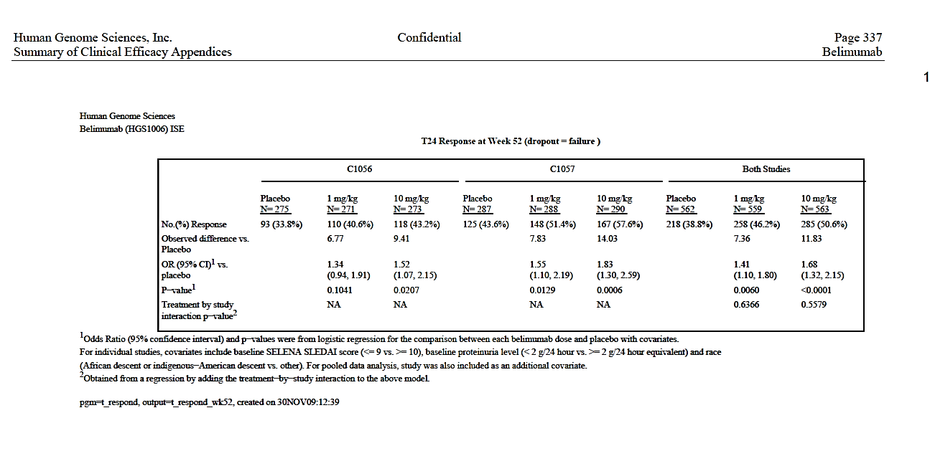
Is our estimate the whole story?
Benlysta Pivotal Trials
Primary comparison for efficacy: Benlysta 10mg vs placebo
Primary endpoint: T24 Response at Week 52
Should we be surprised?

Slide 4

Is our estimate the whole story?
Benlysta Pivotal Trials
Primary comparison for efficacy is Benlysta 10mg versus placebo
Primary endpoint: T24 Response at Week 52
Population
Sample

Slide 5
Uncertainty
How do we capture this uncertainty in our results?
Standard Error Confidence Intervals

Slide 6
What is Standard Error?
Standard error is the standard deviation (SD) of a statistic based on samples drawn from the same population
The smaller the standard error, the greater the precision in the estimate.
Standard
Treatment Group n LSMean Error
--------------------------------------------
Placebo (N=18) 17 4.77 2.068
GSK2982772 60mg (N=33) 28 2.10 1.594
Mean of LSMeans
SD of LSmeans = SE
GSK LSMeans
(based on different random samples)
YouTube video

Slide 7
What is Standard Error?
Standard error is the standard deviation (SD) of a statistic based on samples drawn from the same population
The smaller the standard error, the greater the precision in the estimate.
Standard
Treatment Group n LSMean Error
--------------------------------------------
Placebo (N=18) 17 4.77 2.068
GSK2982772 60mg (N=33) 28 2.10 0.594
Mean of LSMeans
SD of LSmeans = SE
GSK LSMeans
(based on different random samples)
YouTube video

Slide 8
What is a Confidence Interval?
A confidence interval gives a range of true (population) effects for which the observed result is a plausible outcome.
How we are defining plausible?
  Determined by the level of the CI (e.g. 95%)
Standard 95% CI
Treatment Group n LSMean Error (lower, Upper)
----------------------------------------------------------
Placebo (N=18) 17 4.77 2.068 (0.28, 8.12)
GSK2982772 60mg (N=33) 28 2.10 0.594 (1.06, 3.14)
0 1 2 3 4
True (population level) Treatment Effect

Slide 9
What is a Confidence Interval?
The width depends on:
  Sample size
  Variability of the data
  Chosen level of confidence
    (It doesn’t have to be 95%)
Observed value
99% confidence
95% confidence
90% confidence
Statistical significance & CI
A result is statistically significant at the 5% (two-sided) level, if the 95% CI for the treatment difference does not contain the null (“no-effect”) value.
Statistical significance & CI
A result is statistically significant at the 10% (two-sided) level, if the 90% CI for the treatment difference does not contain the null (“no-effect”) value.
50% confidence
Possible true values
Null value

Slide 10
Statistical Significance vs Clinical Importance
Example: Treatment difference & 95% CI
P-value
0.38
0.04
0.01
0.007
Statistical significance
is based on a p-value and our chosen level of what is not plausible (e.g. 5%)
Clinical importance
is the practical importance of a treatment effect. To be of clinical importance, the estimate and the associated CI must be above the minimal clinically important difference.
A) Not significant and not important
B) Significant and possibly important
C) Significant, but not important
D) Significant and important
Null value
Min. clin. relevant

Slide 11
Eli Lilly Alzheimer’s Disease (AD) Solanezumab
EXPEDITION TRIALS
EXPEDITION 1
Mild-Moderate AD
Two identical Phase 3 trials in Mild-Moderate AD started in 2009
Primary endpoint is ADAS-Cog11 at 18 months
N=500 per arm
Secondary endpoint of ADAS-Cog14 (endpoint used for mild disease).
EXPEDITION 2
Mild-Moderate AD

Slide 12
Eli Lilly Alzheimer’s Disease (AD) Solanezumab
EXPEDITION TRIALS
EXPEDITION 1
Mild-Moderate AD
Failed secondary endpoint
Mean difference in ADAS-Cog14
mild-moderate AD
-1.4 (p=0.09)
Failed co-primary endpoints
Prespecified subgroup analysis
Mild vs Moderate disease
(p<0.05)
EXPEDITION 2
Mild-Moderate AD

Slide 13
Eli Lilly Alzheimer’s Disease (AD) Solanezumab
EXPEDITION TRIALS
Protocol target for mild
(based on subgroup analysis)
EXPEDITION 1
Mild-Moderate AD
Failed secondary endpoint
Mean difference in ADAS-Cog14
mild-moderate AD
-1.4 (p=0.09)
EXPEDITION 2
Mild-Moderate AD
Failed primary endpoint
Mean difference in ADAS-Cog14
mild AD
-1.7 (p=0.06)r
EXPEDITION 3
Mild AD
Failed primary endpoint
Mean difference in ADAS-Cog14
mild AD
-0.8 (p=0.10)
How did this happen?
-4 -3 -2 -1 0 0.5
Mean difference in ADAS-Cog14

Slide 14
Eli Lilly Alzheimer’s Disease (AD) Solanezumab
EXPEDITION TRIALS
Protocol target for mild
(based on subgroup analysis)
EXPEDITION 1
Mild-Moderate AD
Failed secondary endpoint
Mean difference in ADAS-Cog14
mild-moderate AD
-1.4 (p=0.09)
N=500 per arm
Any effects in this range could be the true effect!
EXPEDITION 2
Mild AD
Failed primary endpoint
Mean difference in ADAS-Cog14
mild AD
-1.7 (p=0.06)r
N=350 per arm
More precision reveals lower true effects are most likely
EXPEDITION 3
Mild AD
Failed primary endpoint
Mean difference in ADAS-Cog14
mild AD
-0.8 (p=0.10)
N=1000 per arm
-4 -3 -2 -1 0 0.5
Mean difference in ADAS-Cog14

Slide 15
Key Messages
Uncertainty exists, acknowledge it
What do you need to do?
Identical trials do not give identical results.
Don’t take a result as truth
Confidence intervals and standard errors help us communicate this variability.
Our result is an estimate - not the true effect.
Acknowledge and know the level of uncertainty in the estimate you are quoting in you in claims
Remember to consider both statistical significance and clinical relevance.

